Slide 1
NMT資格更新について

Slide 2
2022年でNMT資格がきれる方へアカデミーから送られてきたメール
Good afternoon,
I hope you are doing well! I just wanted to reach out to share the reminder that your NMT Affiliate Status will be expiring at the end of this calendar year (2022). For many of you, the NMT model guides your clinical work and teaching, and is often used in the title of your business or in your mission or philosophy statements to define what sets your practice apart. The NMT Trainings and knowledge base have developed and evolved immensely over the years, and we strongly encourage you to stay active in the NMT Academy in order to ensure that you continue evidence-based practice and standards of best practice.
We’ve recently amended the requirements to maintain your affiliate status to make the renewal process easier for you. The Advanced Fellowship is no longer required to maintain your affiliation but instead we have moved to a continued professional development system, which means 2022 expiring affiliates can maintain their professional affiliation by completing 10 NMT Professional Development credits by the end of 2022 and logging them here: https://docs.google.com/forms/d/e/1FAIpQLSdY4IpmXvgylZj05-1zgmdcWEEmsRt_1NVQ9kGq6W0lVEWV-A/viewform?usp=sf_link. Please remember that these Professional Development credits may be applied to other professional organizations’ requirements for continuing education/professional development (CMTEs, MOC, etc.).
You can fulfill this requirement through a variety of ways, and you can find all of those on the Academy Website, https://nmtacademy.co/professional-development. Please notice that these credits should come from three different Professional Development categories (listed on the website) and that you should attend at least 3 Support Chapter Meetings each year (https://nmtacademy.co/local-support-chapters/).
In response to financial and other pandemic related hardships and in an effort to support the Academy mission to disseminate and advance the worldwide practice of NMT, the Academy invites you to a 10-hour (12 CMTEs) professional development opportunity: The NMT 1st International Clinical Consensus Symposium, to be held Nov. 18-19, 2022. This symposium will provide 10 hours of meaningful high quality professional enrichment at a low cost to NMT Affiliates, allowing them to achieve their continued professional development requirements as well as your support chapter meeting requirements. If you are looking for a quick way to catch up and earn your CPD, don't miss this upcoming opportunity. For more information or to register click here.
If at the end of 2022, you have completed the NMT Professional Development requirements, your NMT Affiliate status will renew for another 5 years. You are more than welcome to complete your NMT Fellowship at any point if you are interested, but it is no longer a requirement unless you are an NMT-F and wish to maintain this status (https://nmtacademy.co/training-opportunities/nmt-fellowship-training/).
Please let us know if you have any questions!
Best,
Kim
次のスライドに、このメールで重要だと思うことの日本語訳を載せてます。

Slide 3
2022年末にアカデミー会員資格がきれる方へのメール
NMT研修を受けた方は必ずしもフェローシップ研修を受ける必要はない。その代わりに、2022年末までにアカデミー教育研修10単位分を取得する必要がある。
単位はこちらから入力する。 logging them here: https://docs.google.com/forms/d/e/1FAIpQLSdY4IpmXvgylZj05-1zgmdcWEEmsRt_1NVQ9kGq6W0lVEWV-A/viewform?usp=sf_link
これらの単位分、例えば学会参加などは、MT学会の単位分と併用して構わない。
単位に関しては、アカデミーのウェブサイトで確認できる。
https://nmtacademy.co/professional-development
単位は、(最低)3群(アカデミーの教育研修表参照）から取得する必要がある。また、最低年3回はサポートグループミーティングに参加する必要がある。
11月18日19日に開催される第1回NMT国際臨床コンセンサスシンポジウムは10時間の教育研修を取得する機会である。(また、サポートグループミーティングとしてもカウントできるらしいです)
2022年末までに、必要な教育研修単位を取得した場合、NMT会員資格は次の5年間有効となる。フェローシップ研修を受講希望の方は、是非受講をおすすめするが、会員資格を更新するのに必ずしも必須ではない。ただ、NMTフェローシップの取得および更新には、フェローシップ研修会を受講する必要がある。https://nmtacademy.co/training-opportunities/nmt-fellowship-training/

Slide 4
アカデミーの教育研修
Professional Development
If our Affiliation is for 5 years, does this mean that I add two more years onto my expiration year?
Because we rolled out the Professional Development program with many affiliates already within various timelines of expiration, we’ve prorated the credits current affiliates will need to earn to maintain their affiliate status. If you were set to expire in 2022, you still are regardless of the new professional development program. You will now need to earn 10 credits over the course of 2022 to maintain your affiliate status, which will then renew for another 5 years at the end of 2022.
If you are due to expire in 2023, you will need to collect 20 credits before the end of 2023
If you are due to expire in 2024, you will need to collect 30 credits before the end of 2024
If you are due to expire in 2025, you will need to collect 40 credits before the end of 2025
If you are due to expire in 2026, you will need to collect 50 credits before the end of 2026
Can I use a conference from 2020 or 2021 toward my required credits?
Opportunities before 2022 or before your NMT Training will not be accepted towards your required NMT Professional Development credits.
NMT FAQs – The Academy of Neurologic Music Therapy (nmtacademy.co)

Slide 5
アカデミーの教育研修
2022年で資格がきれる会員 10単位取得必要
2023年 20単位
2024年 30単位
2025年 40単位
2026年 50単位
単位は2022年前はカウントしない。例えば、2022年より前の学会参加などはカウントしない。
研修会参加前もカウントしない。
(＊2022から新しい更新システムに変更されているので、2022年で資格がきれる方は10単位、2023年は20単位の単位取得・・・、で更新となっておりますが、再更新した後は資格は5年間有効で、再々更新の際には、50単位を取得している必要があります。）

Slide 6
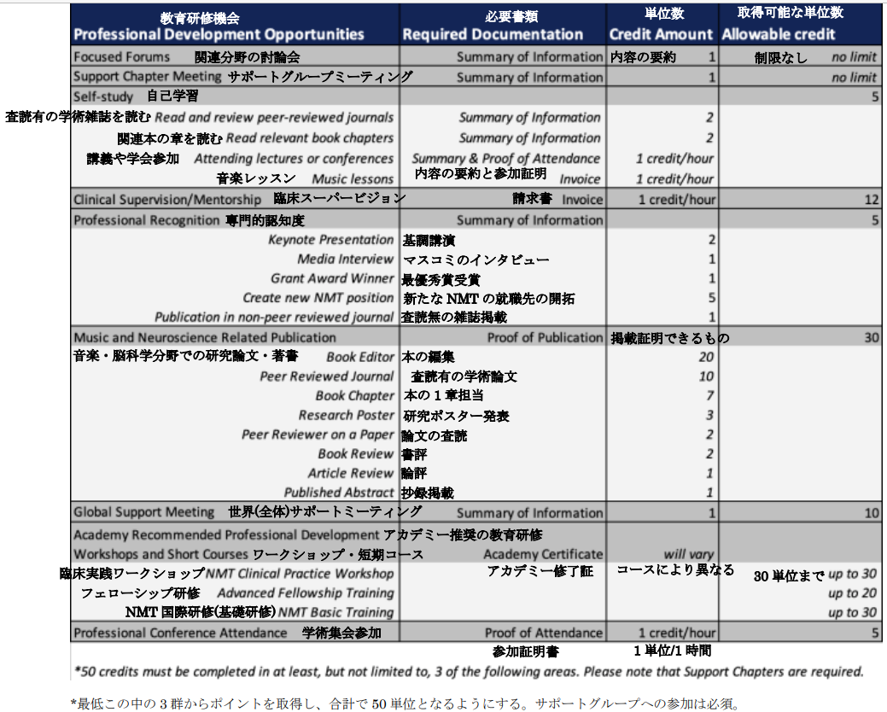
教育研修
NMTアカデミー | NPO法人 日本神経学的音楽療法協会 (jnmt.org)

